Slide 1
Portfolio Website
Ayush Luthra

Slide 2
Agenda
Introduction
About Technologies
About Portfolio
Features
References
Summary

Slide 3
Introduction
This Project is a Template of Portfolio Website. The technologies used in this project are:-
HTML5
CSS3
BS4

Slide 4
About Portfolio

Slide 5
Portfolio
A Portfolio is a professional document used to describe an individual in the profession he follows. A portfolio can be in the form of a document or a website. A portfolio defines an individual as an asset to his following profession and is similar to a resume.

Slide 6
About Technologies

Slide 7

HTML
HTML stands for Hyper Text Markup Language. It is a markup language that is used to design the skeletal structure of a web page. The version of HTML used in project is HTML5.

Slide 8
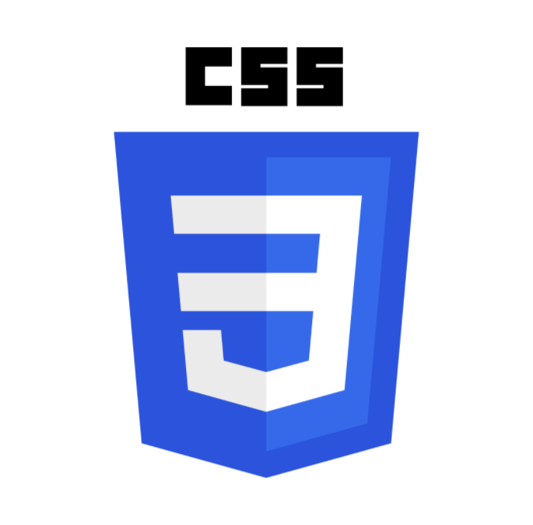
CSS
CSS stands for Cascading Style Sheet. It was developed to make web page designing easier with respect to the primitive ways of designing where HTML attributes were used to design the web page. In short, it is a language that is used for designing a web page. It is like a skin of a web page.
The version of CSS used in project is CSS3.

Slide 9

BootStrap4
Bootstrap is a framework of CSS. It uses CSS selectors (especially class selector) to set up the designing component in HTML. It consists of premade custom styles designed in CSS & JS. It is used to make beautiful and standardised responsive designs that follows mobile first approach. The version of BS used in project is BS4.

Slide 10
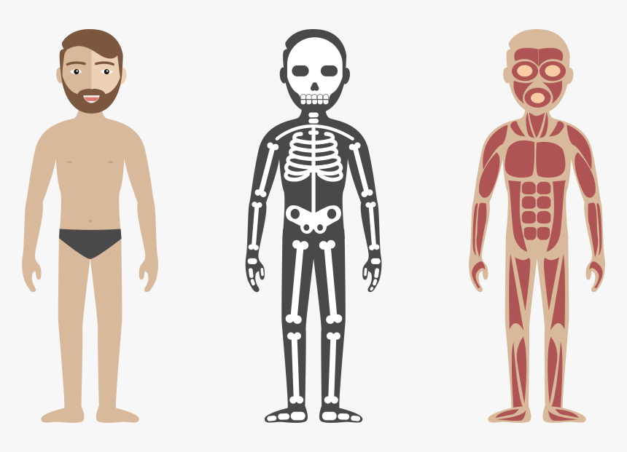
Web Development Structure
CSS
HTML
BS4(JS)

Slide 11
Features

Slide 12
Features
Shows the blogs you made to let people read them.
Recommend
Provides recommendations of your work
Technology
Tells about the technologies/skills you are specialized in with level information.
Design
Evergreen and elegant design that fits every screen size.
Shows the work you did.
Blogs
Projects
1
2
3
4
5

Slide 13
Design is what makes the attraction and the hence Frontend is the eyecatcher of the viewers
“
”
Ayush Luthra

Slide 14
References
YOUTUBE
Blogs
W3 Schools
https://www.youtube.com/channel/UCrSjZrENoMIvpB5ZjE8n_Ug
https://bhartiyasofttech.wixsite.com/website.
https://www.w3schools.com

Slide 15
Summary
Today we covered what is a PORTFOLIO, why it is used.
We also covered HTML, CSS and BS4.
And also we have gone through what my portfolio template provides to its users.

Slide 16
Thank you
Ayush Luthra
35915602719
T2
ayushluthra24@gmail.com

